Slide 1
ACCIDENT SEVERITY PREDICTION
CS513 B
Knowledge Discovery and Data Mining

Slide 2




Group Members
Hemanth Kumar Pappu
20012668
Pooja Pesaru
20011593
Bhaskara Sai Vamsi Krishna Padala
20025924
Thejesh Ravikumar
20021148

Slide 3
Introduction
Objective | Dataset Overview
Data Preprocessing
EDA | Data Preprocessing | Feature Engineering | Handling Imbalances | Clustering Techniques
Classification Algorithms Used
Logistic Regression | Random forest | Support Vector Machine | Naïve bayes | CatBoost | Decision tree | AdaBoost | XGBoost

Slide 4
Introduction
Objective:
Develop a precise predictive model for traffic accident severity in the United States using the US-Accidents dataset. This model will enhance road safety, inform emergency responses, and guide traffic management policies.
Dataset Overview:
The US-Accidents Dataset comprises 7.7 million records of US traffic accidents from February 2016 to March 2023. It covers factors like environmental conditions, road state, and traffic patterns, crucial for determining accident severity.
(Dataset)

Slide 5
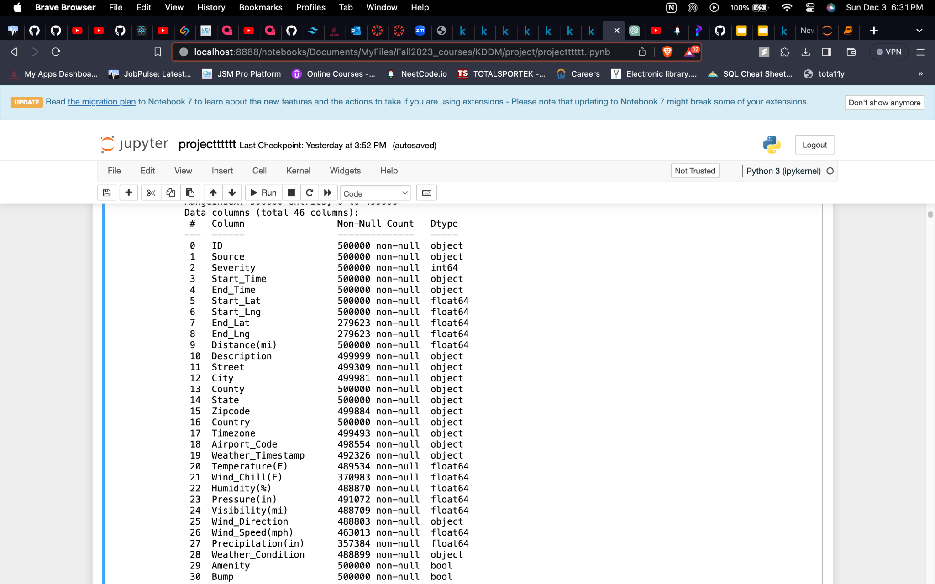
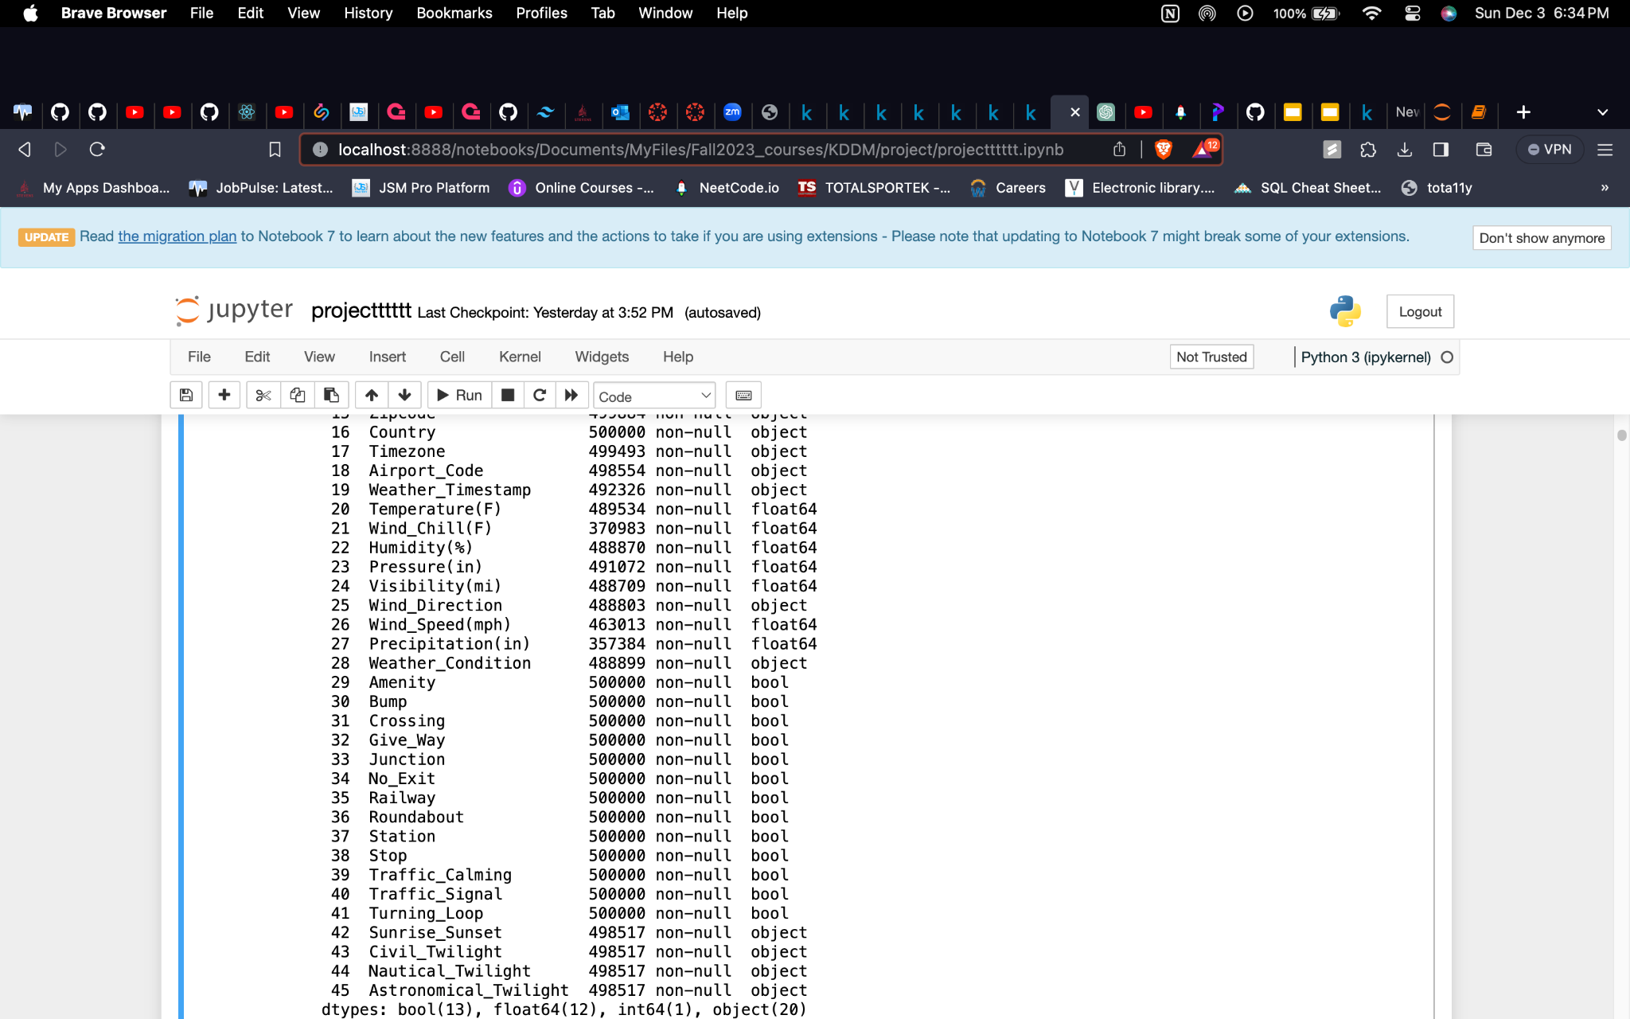
Features
These are the initial 46 features present in the dataset, the object data type here represents strings.

Slide 6
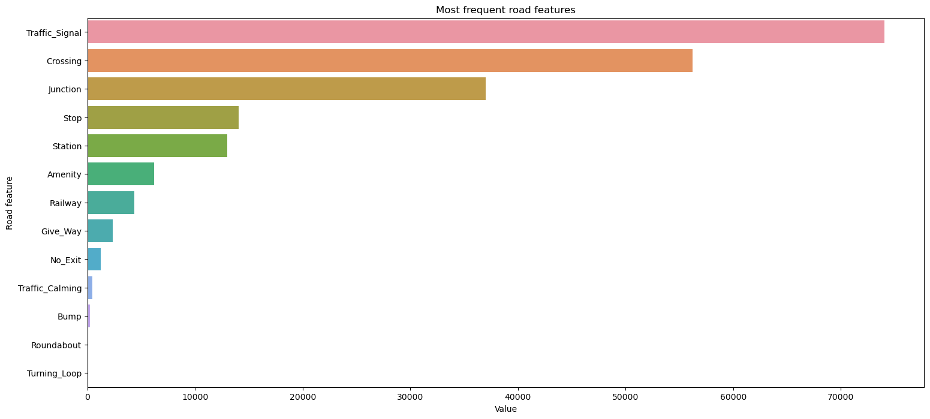
EDA:

Slide 7
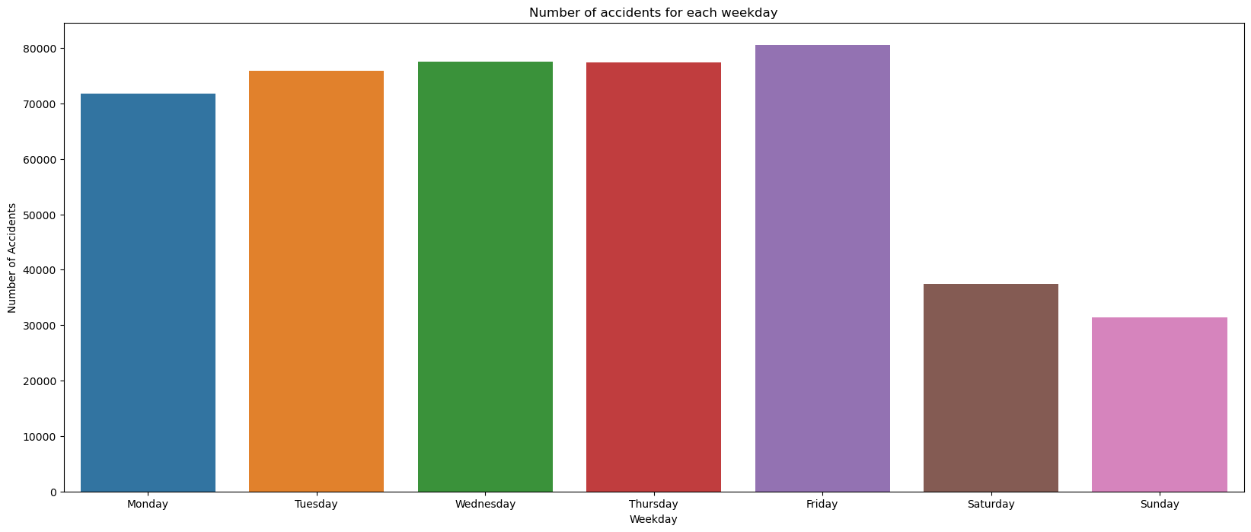

Slide 8
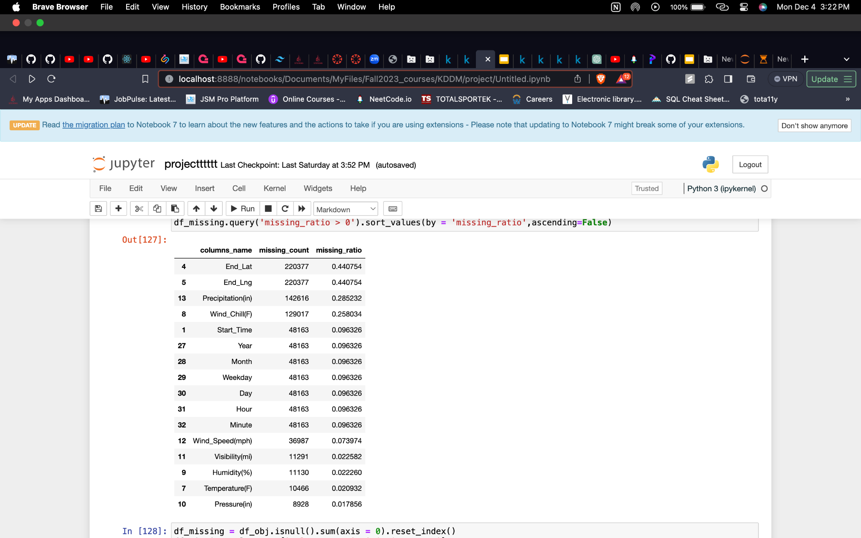
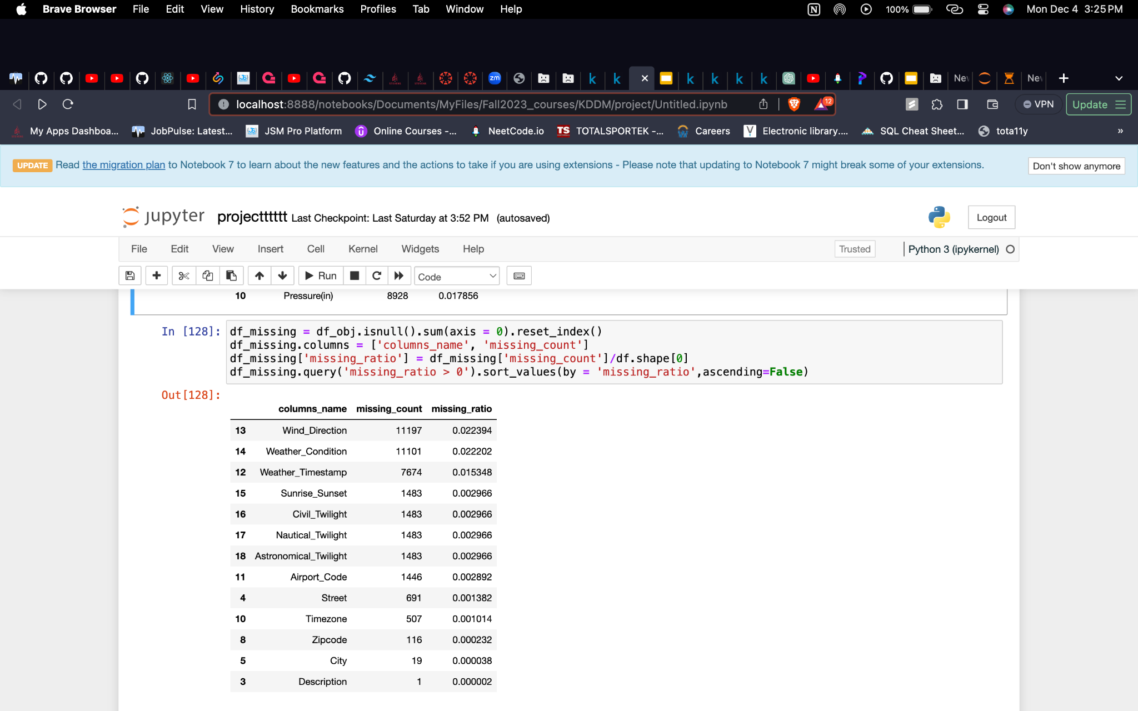
Data Preprocessing
Our first instinct would be splitting the huge data into numerical and categorical columns for proper data exploration.

Slide 9
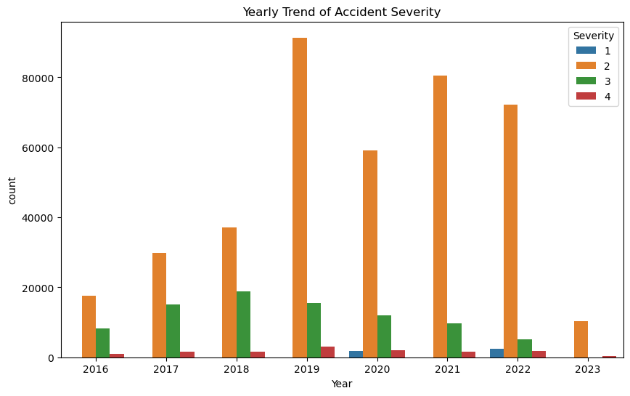
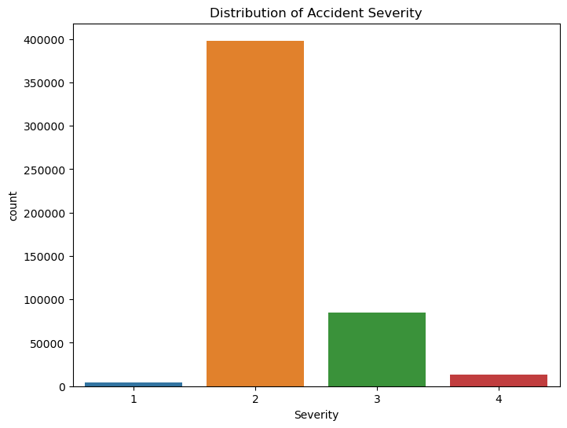

Slide 10
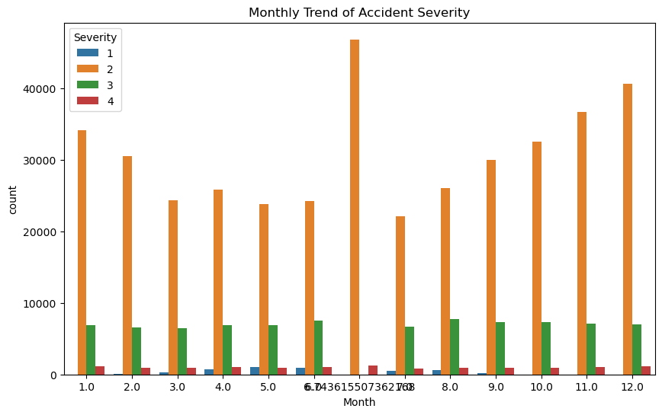
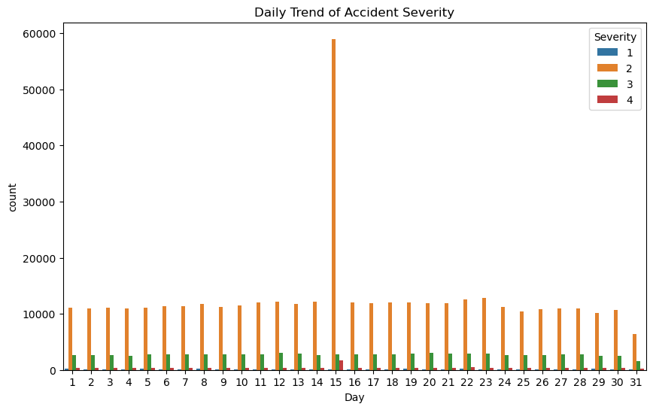

Slide 11
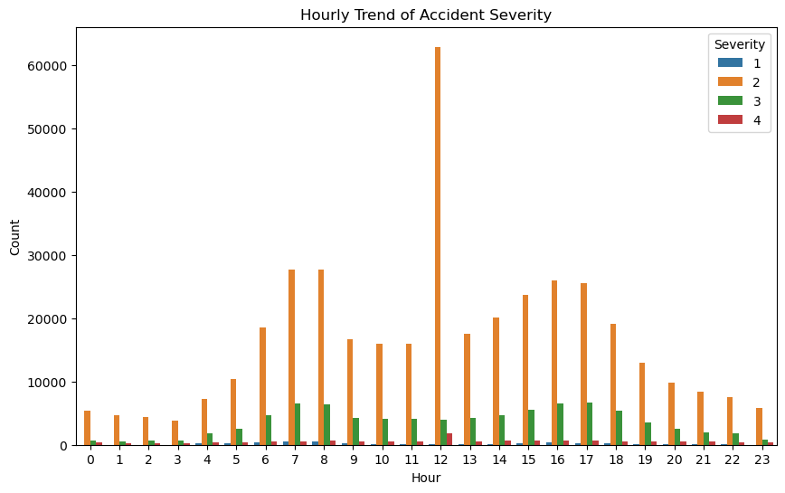
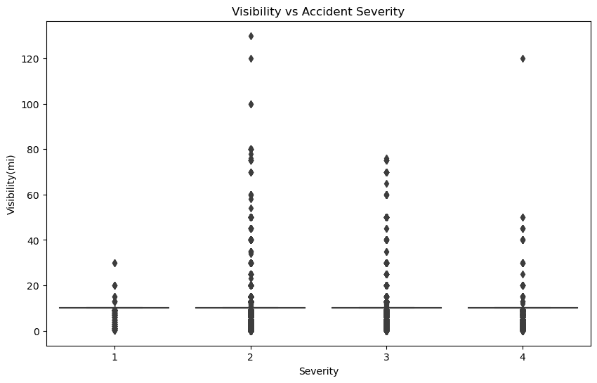

Slide 12
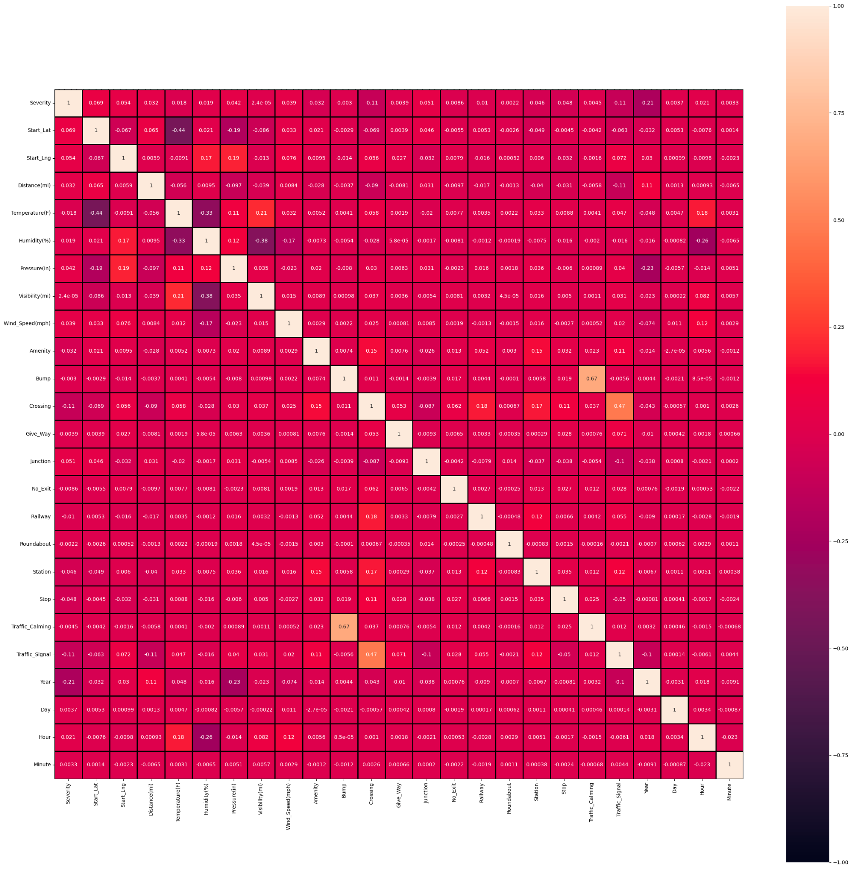
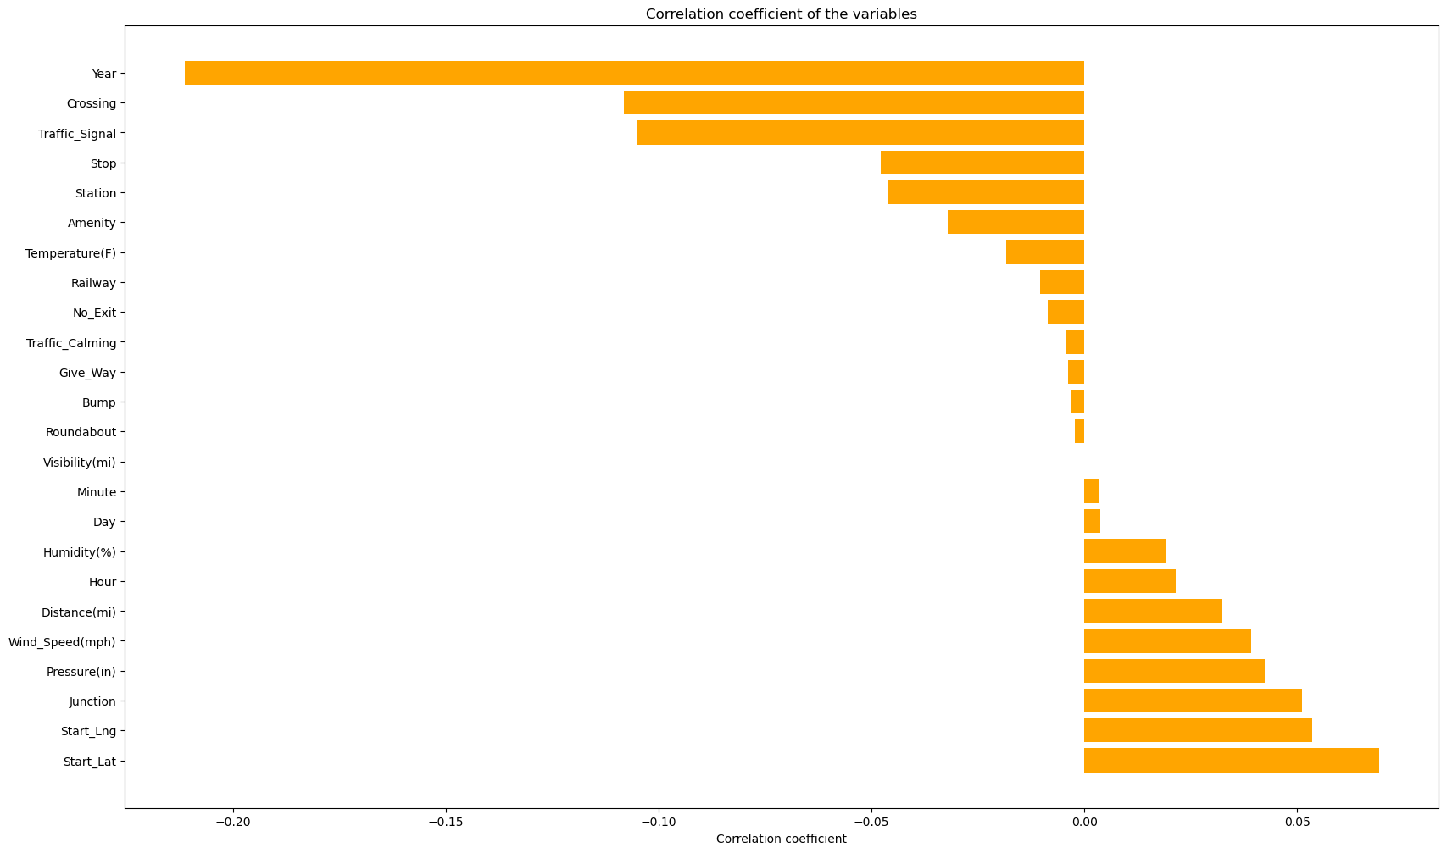
Correlation

Slide 13
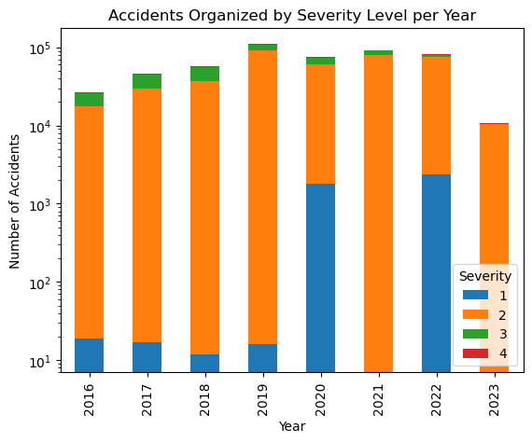

Slide 14
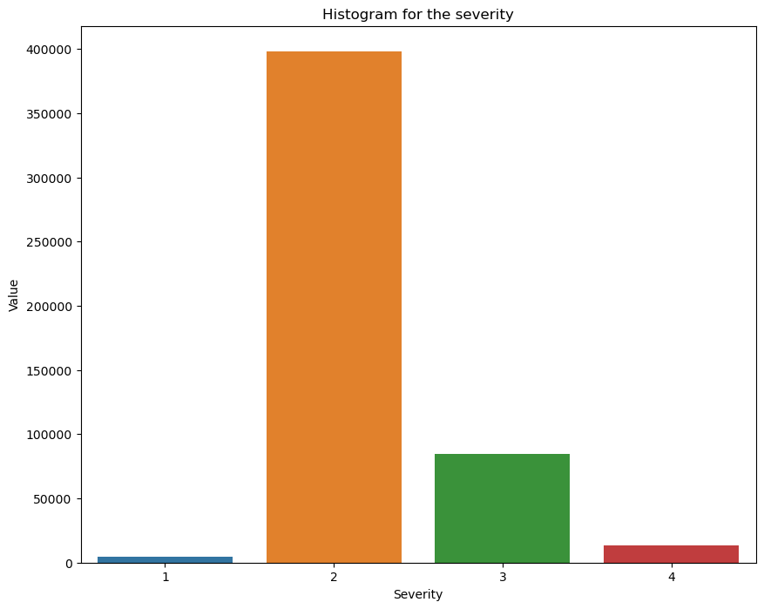
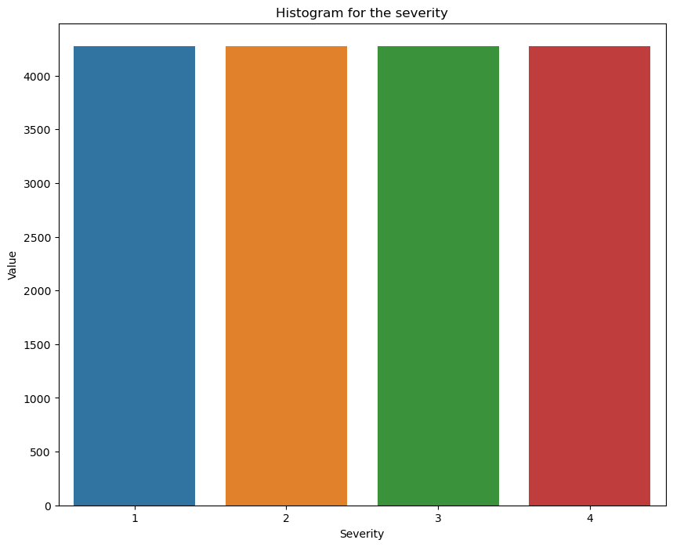
Handling Unbalanced Data

Slide 15
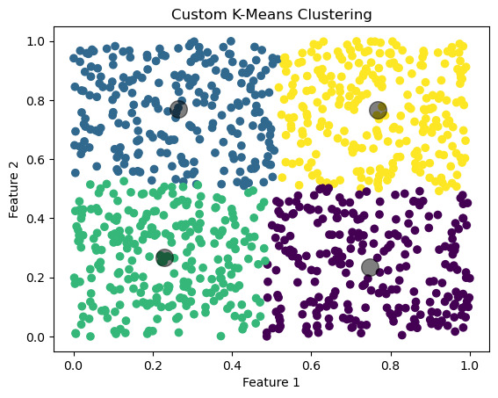
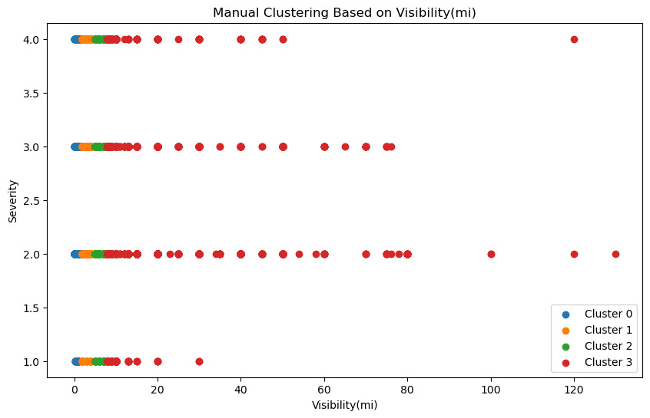
Clustering

Slide 16
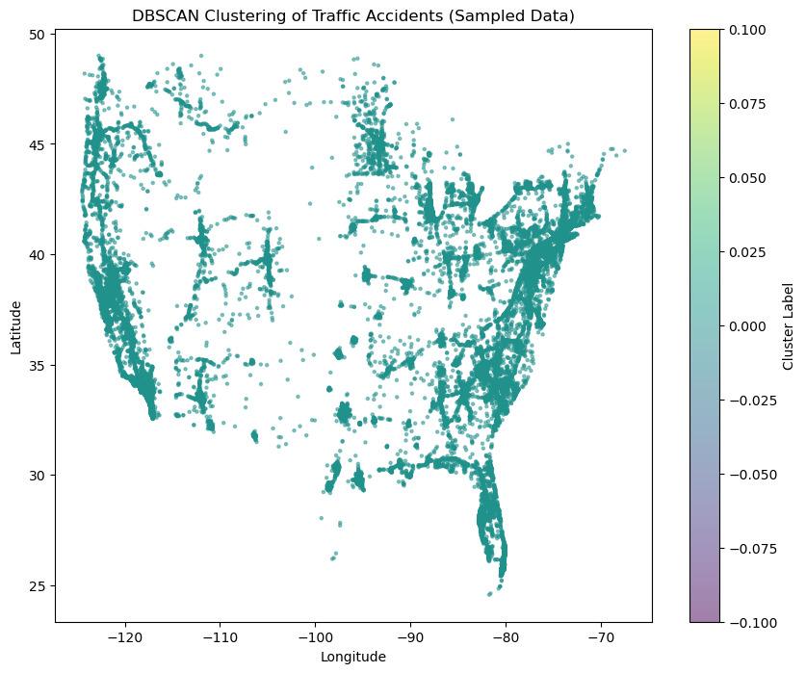
DBSCAN:

Slide 17
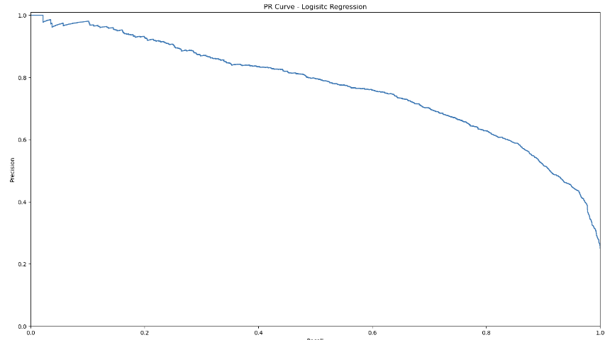
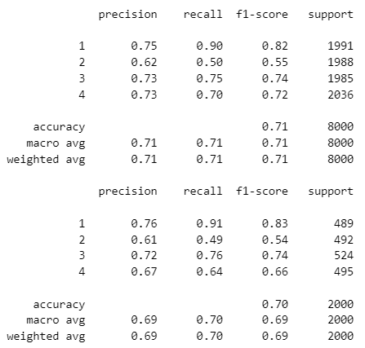
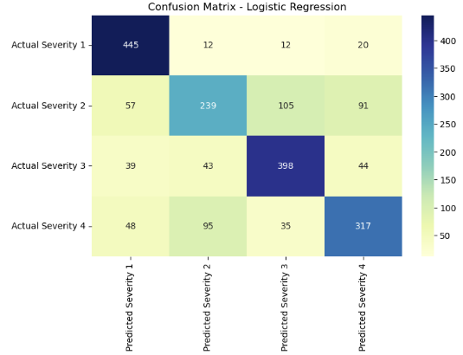
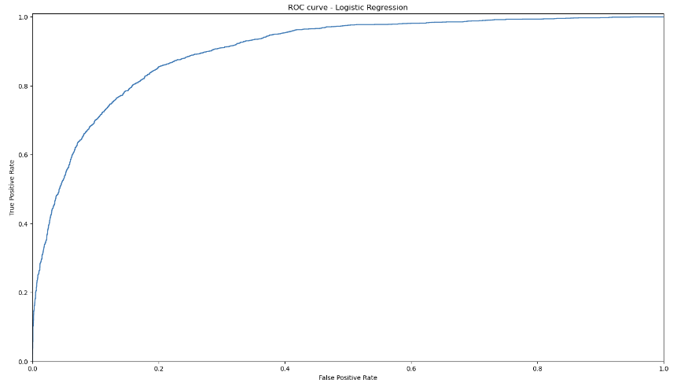
Logistic Regression:

Slide 18
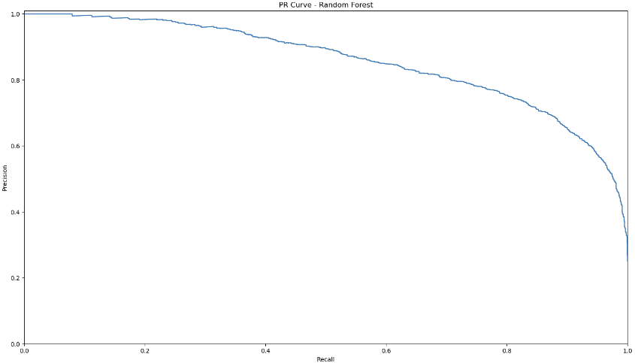
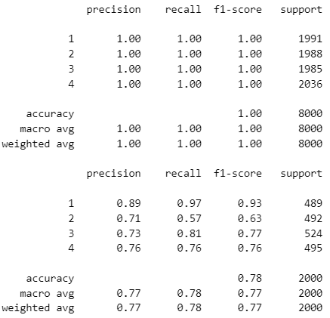
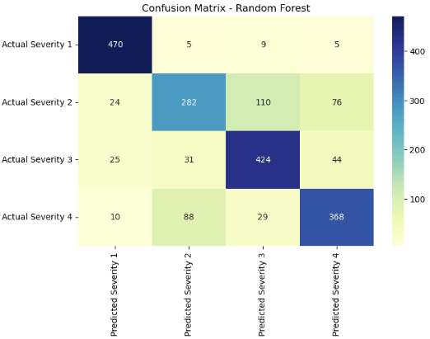
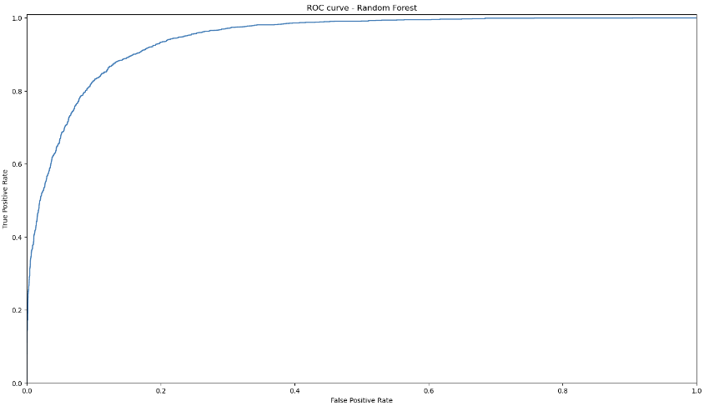
Random Forest:

Slide 19
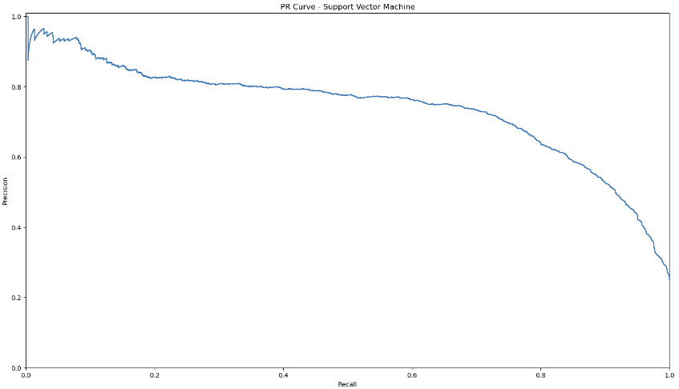

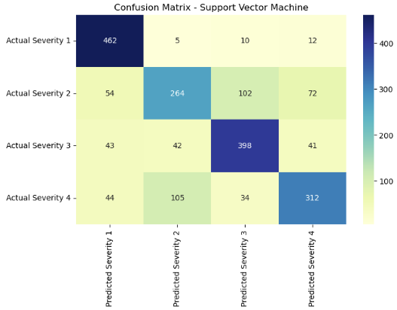
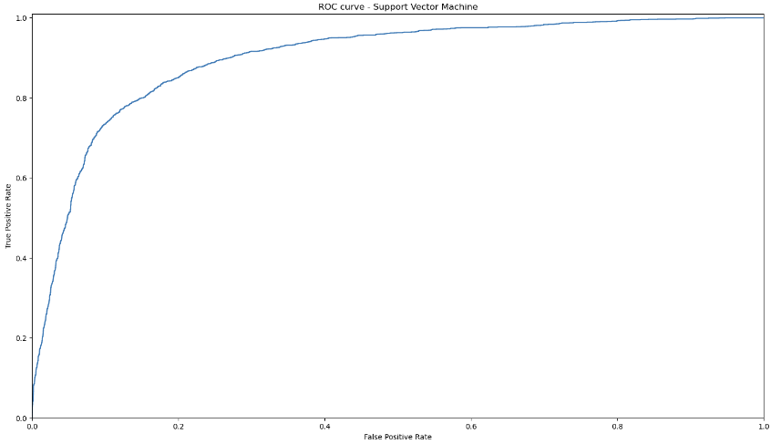
Support Vector Machine:

Slide 20
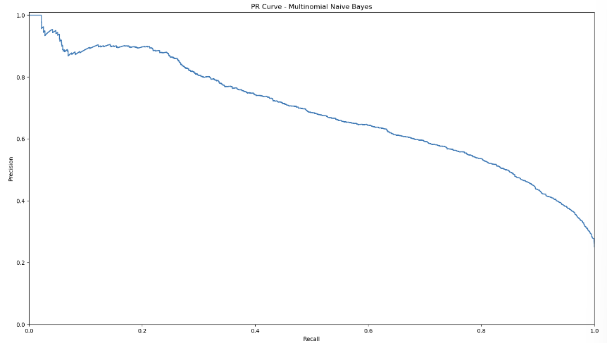
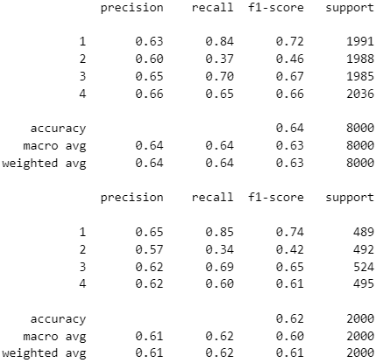
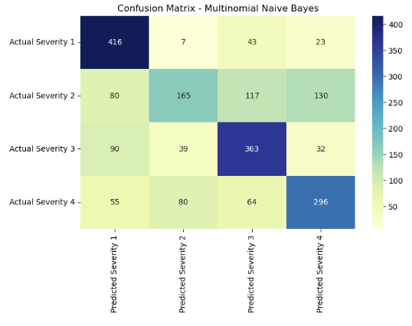
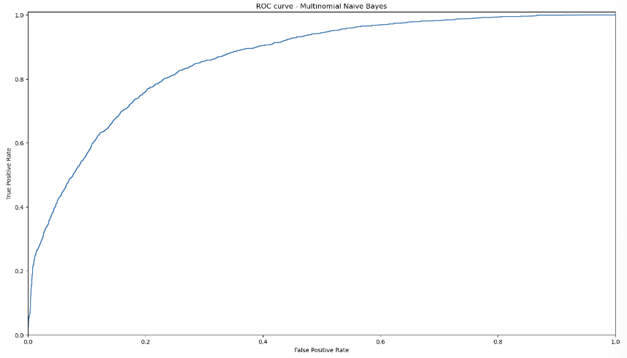
Naive Bayes:

Slide 21
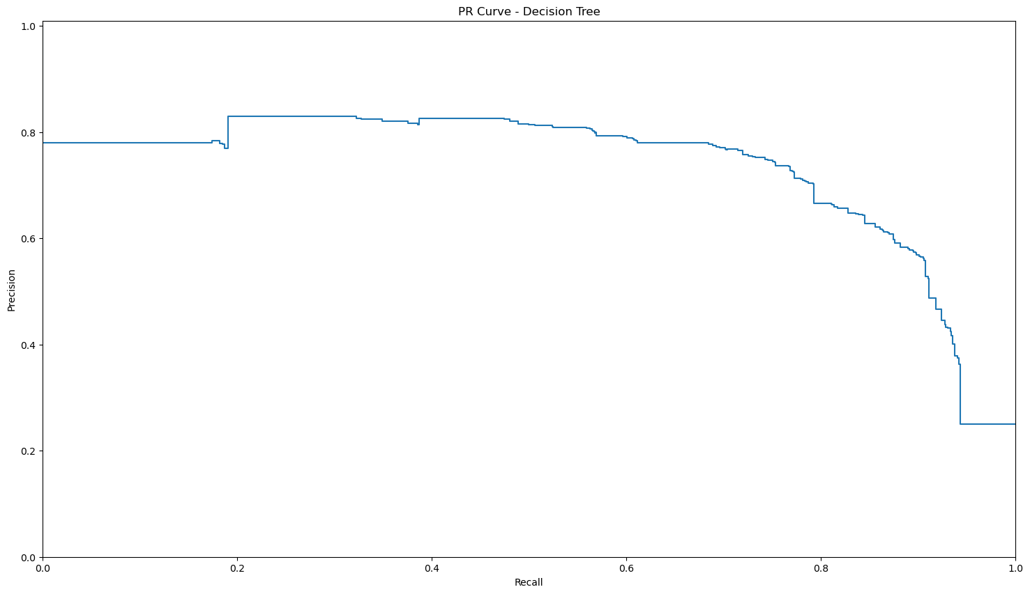
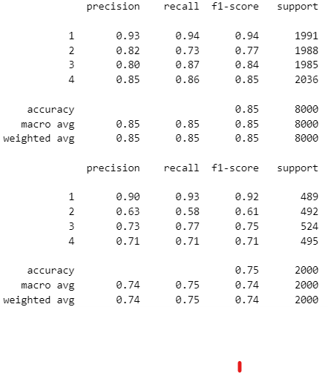
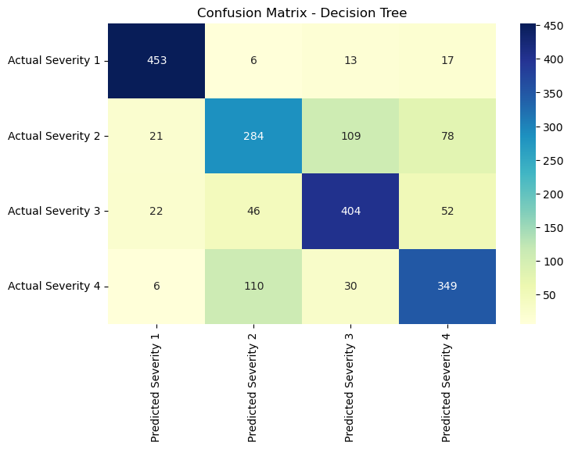
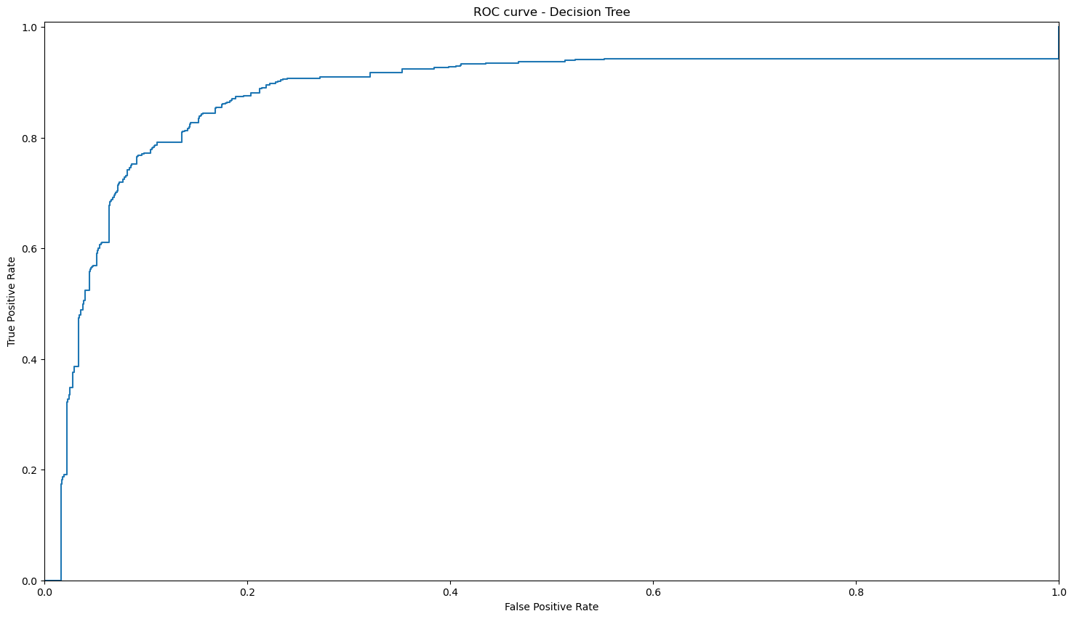
Decision Tree:

Slide 22
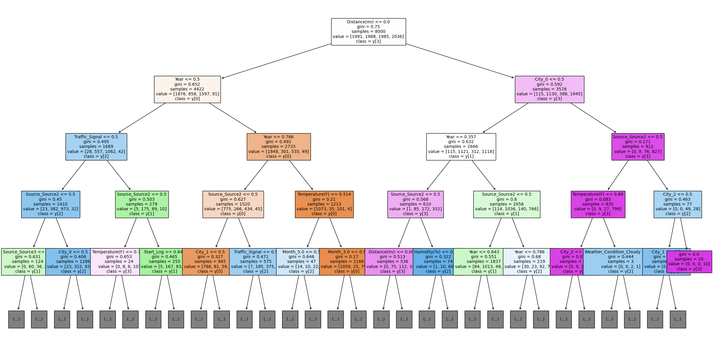

Slide 23
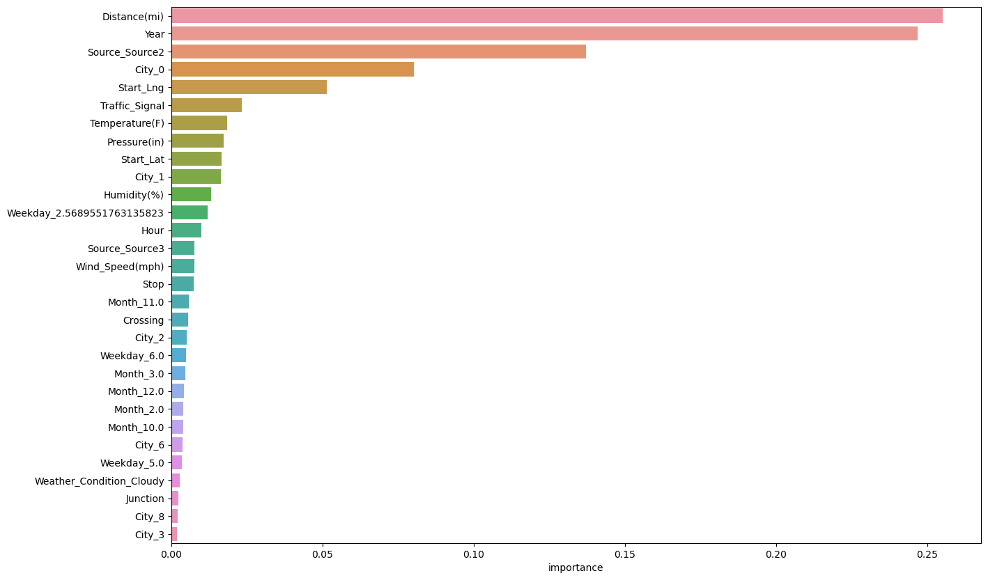

Slide 24
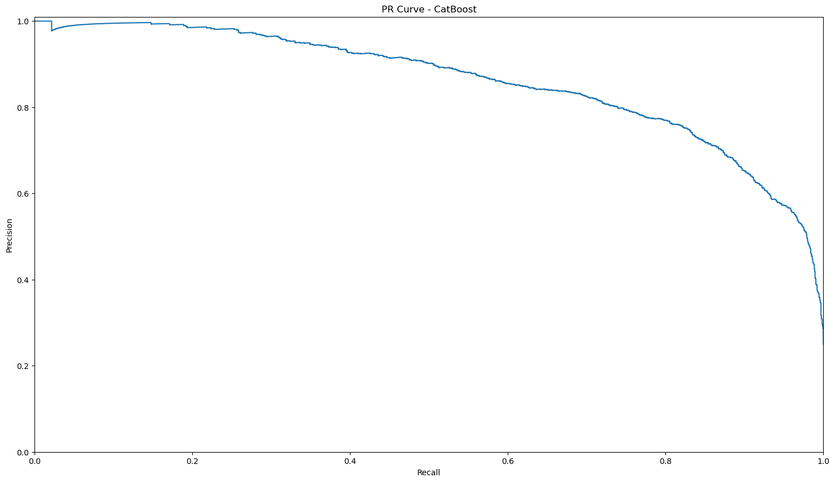
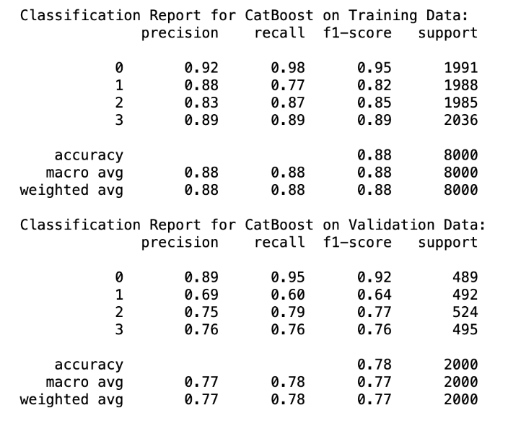
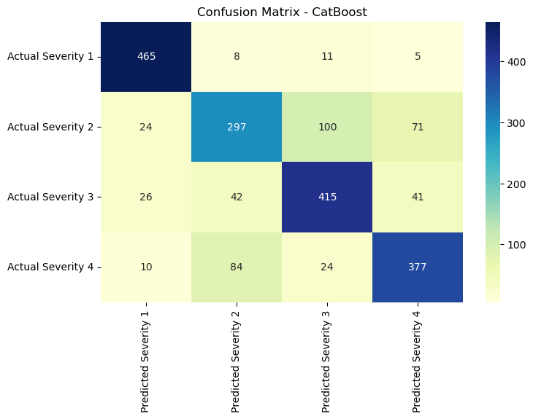
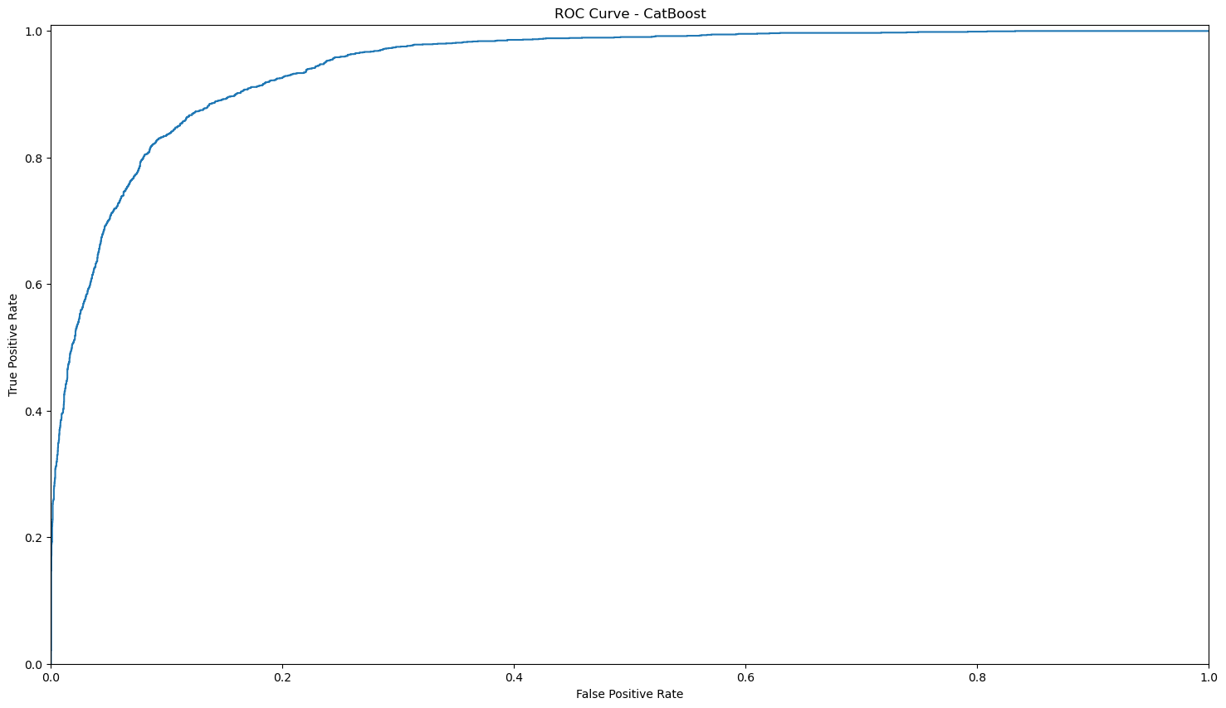
CatBoost classifier

Slide 25
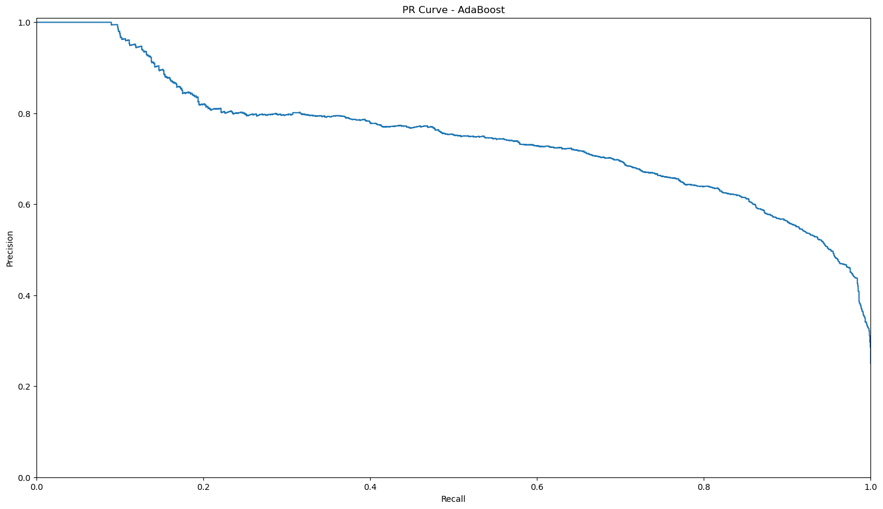
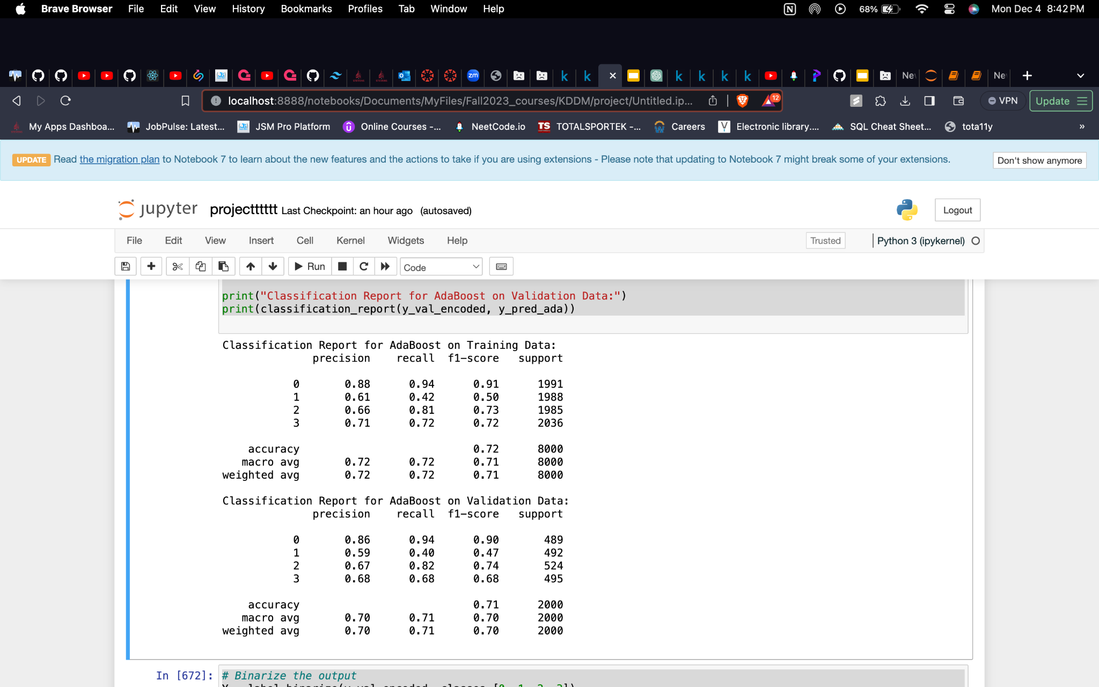
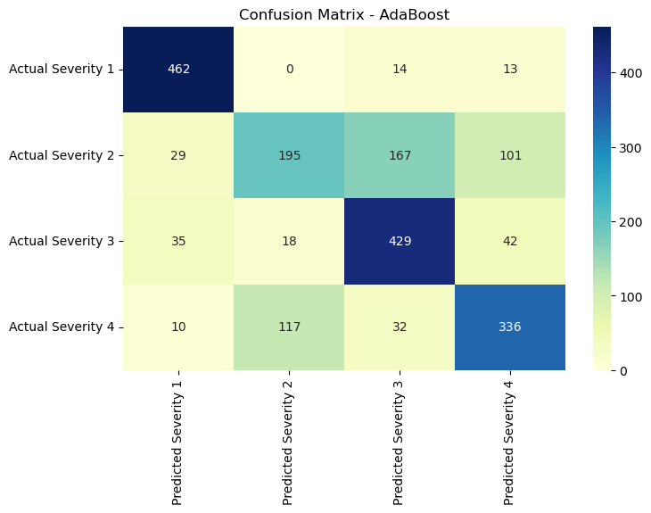
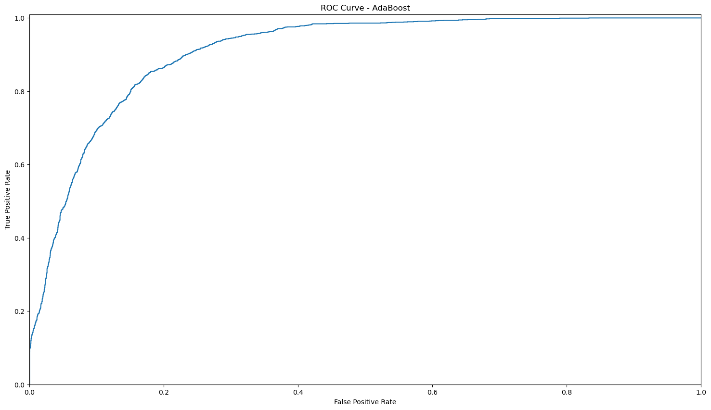
AdaBoost classifier

Slide 26
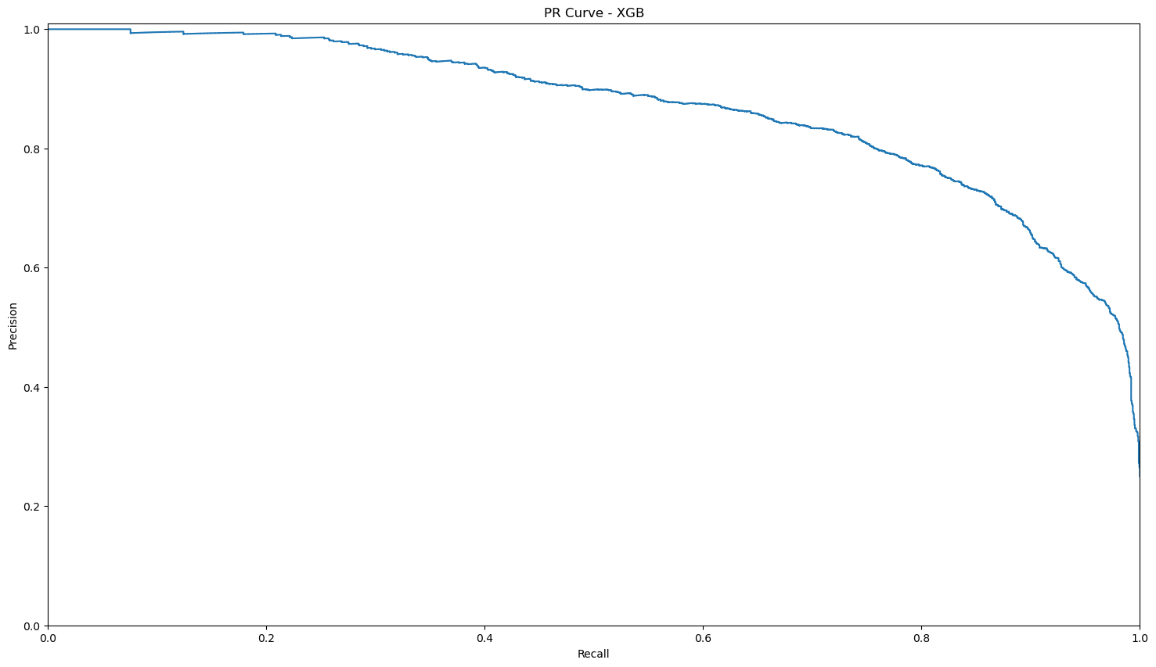



XGBoost:

Slide 27


Conclusion:
XGBoost Algorithm performed the best among the other algorithms based on accuracy, precision, recall, F1-Score, ROC.

Slide 28



Slide 29

Thank you

